Slide 1
Spectrum measurement & channel capacity
Prepared By:
Tawsif Ahmad Luvpreet Kaur Thakur Bhattarai

Slide 2
Equipments used
Software:
SDR SHARP v1.0.0.1700
Hardware:
NooElec R820T2 SDR

Slide 3
Spectrum of Interest
In project 1, we worked on Wi-Fi wireless standard
Wi-Fi works on 2.4 GHz bands (2.412 GHz – 2.484 GHz)
We received some signals in this frequency range
Some of them has been presented in the upcoming slides
We used RF gain 38.6 dB in SDRSHARP

Slide 4
Calculations
Noise Floor, N1 = -120 dBm
Noise floor in Sdrsharp without any valid signal: N2
Power gain of the software: G = N2 – N1
Peak of the valid signal: A
Received power: P = A – G
SNR: A – N2

Slide 5
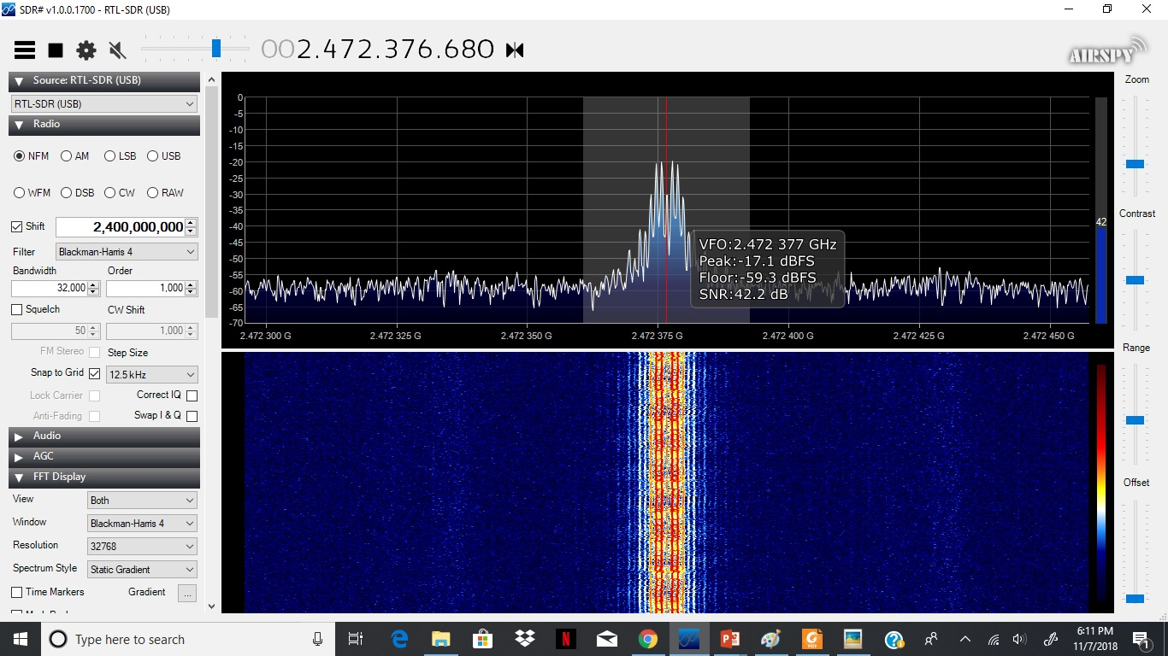
AT 2472376680 Hz
N2 = -59.3 dBm
G = -59.3 + 120 = 60.7 dB
A = -17.1 dBm
P = -17.1 – 60.7 = -77.8 dBm
SNR = 42.2 dB

Slide 6
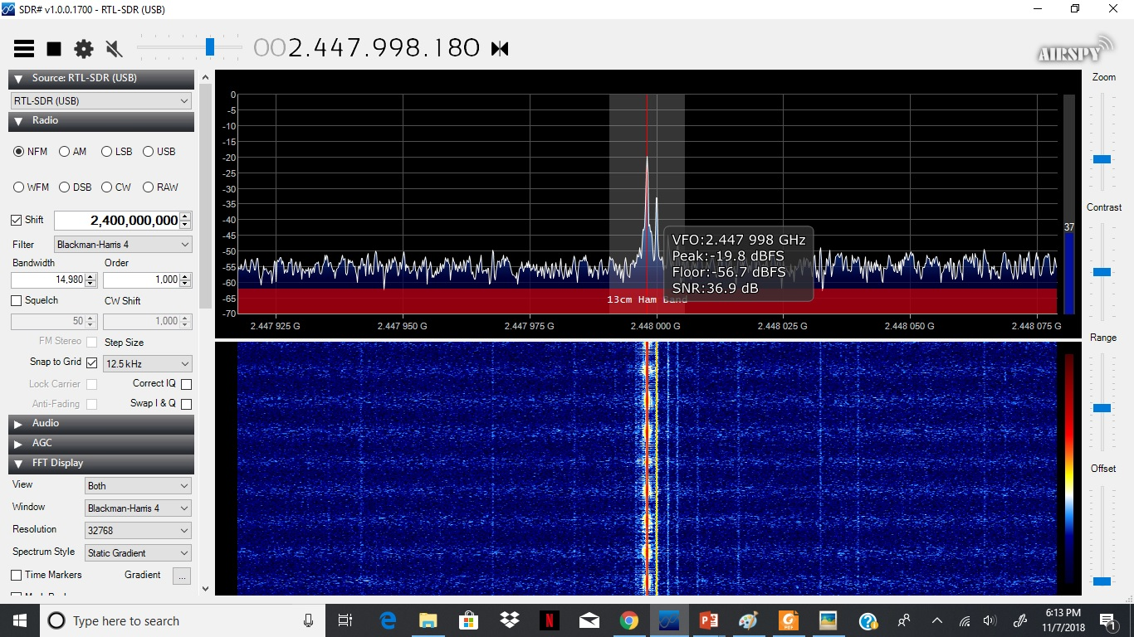
AT 2447998180 Hz
N2 = -56.7 dBm
G = 63.3 dB
A = -19.8 dBm
P = -83.1 dBm
SNR = 36.9 dB

Slide 7
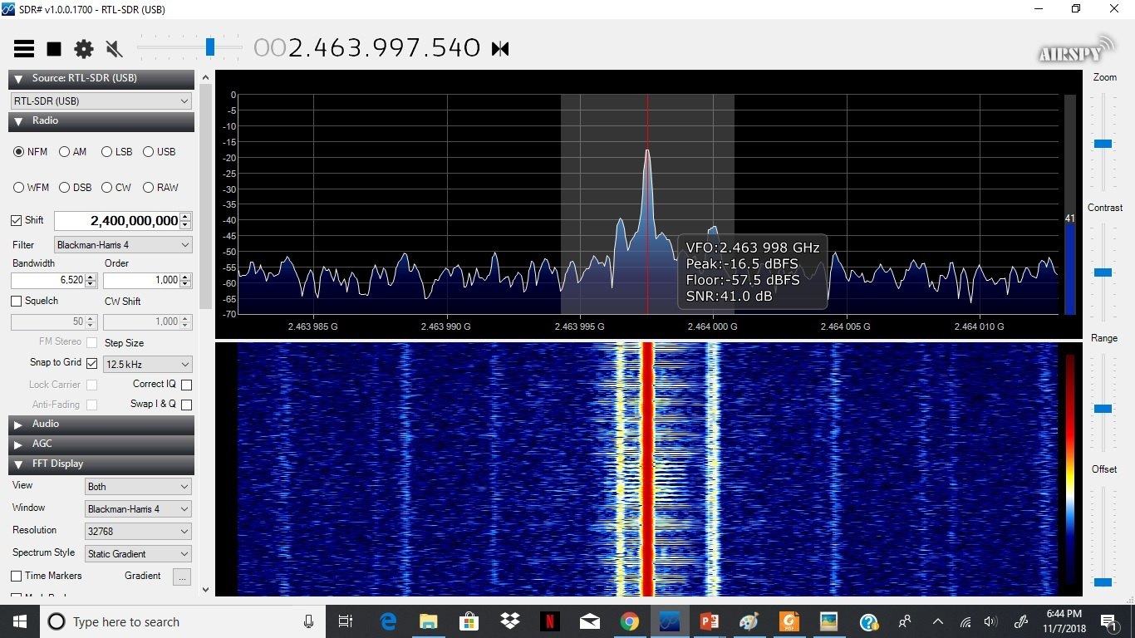
AT 2463997540 Hz
N2 = -57.5 dBm
G = 62.5 dB
A = -16.5 dBm
P = -79 dBm
SNR = 41 dB

Slide 8
Some Observations
The photos here are shown for active signal transmission
When there are no signal transmission, the spikes are a lot smaller.
If we look at the spectrum band at a different place, for example, we tried at the University Union, we got spikes in different frequencies.

Slide 9
Channel Capacity
We considered WHRW-FM 90.5 MHz Radio which is conducted by Binghamton University
The test was done in 109 Schubert Street, Binghamton, NY.
Transmission distance, d = 2.6 miles = 4184.3 m.
Transmitter power = 1450 watts = 61.614 dBm
Wavelength = 3.315 m (approximately)
We used no RF gain in the software

Slide 10
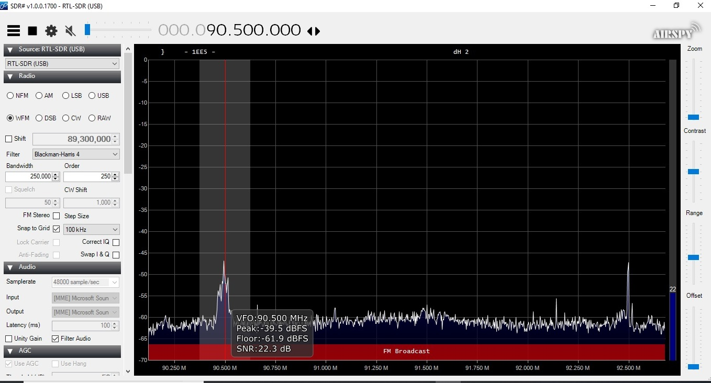
FM Signal Measurement
N2 = -61.9 dBm
G = 58.1 dB
A = -39.5 dBm
Pr = -97.6 dBm
SNR = 22.3 dB

Slide 11

Free Space Path Loss Model
$$P_{r}= P_{t}.{(\frac{\sqrt{G}λ}{4πd})}^{2}$$
Here, G is antenna gain which is assumed to be 1.
d is the distance between transmitter and receiver = 4184.3 m
Pt = 1450 watts
So, using the model we get Pr = -22.4 dBm which is very far from the measured value.
So, we cannot fit this data with the free space path loss model

Slide 12

Two Ray Model
$$P_{r}=P_{t}.{\left(\frac{\sqrt{G}h_{t}h_{r}}{d^{2}}\right)}^{2}$$
Transmitter height = 80 m (from the web)
Receiver height = 6 m and d = 4184.3 m
We get Pr = -29.63 dBm
Which is lot less than the observed value. So, this model doesn’t fit too.

Slide 13


Simplified Path Loss Model
$$P_{r}\left(dBm\right)= P_{t}\left(dBm\right)+K\left(dB\right)−10γ\log_{10}{\frac{d}{d_{0}}}$$
Where, $K\left(dB\right)=20\log_{10}{\frac{λ}{4πd_{0}}}$ and we assume $d_{0}=10 m$
We get, K = -31.58 dB
Using Trial and error, we set $γ$ = 4.8 to obtain
Pr = -95.77 dBm
which is closer to the measured value of -97.6 dBm
SNR = -95.77 dBm + 120 dBm = 24.23 dB

Slide 14
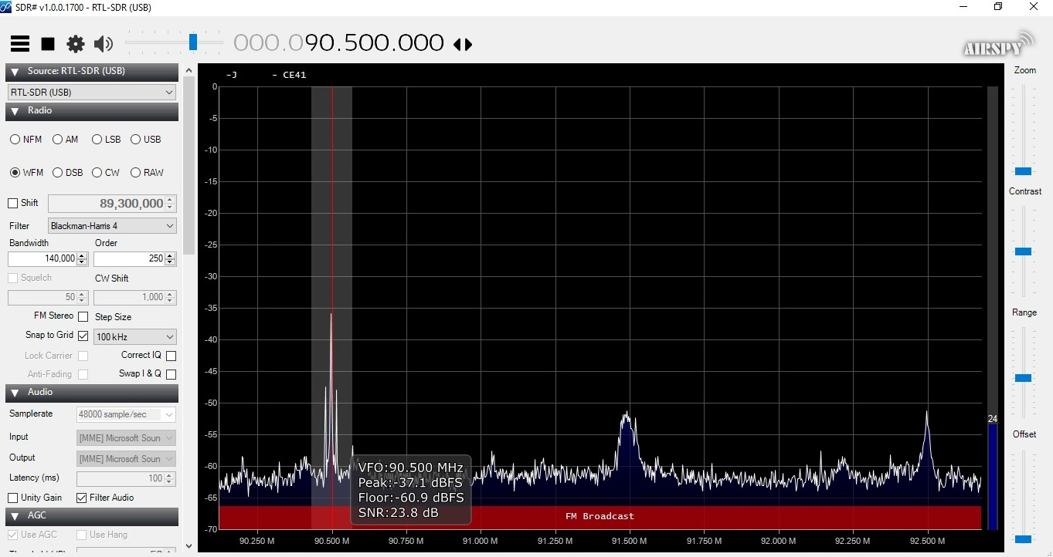
FM Signal Measurement 2
N2 = -60.9 dBm
G = 59.1 dB
A = -37.1 dBm
Pr = -96.2 dBm
SNR = 23.8 dB

Slide 15
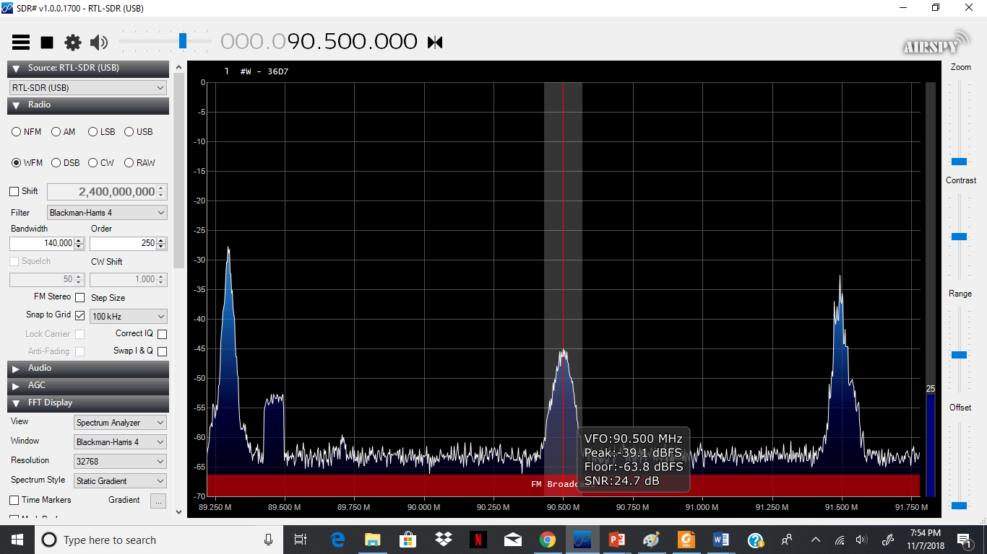
FM Signal Measurement 2
N2 = -63.8 dBm
G = 56.2 dB
A = -39.1 dBm
Pr = -95.3 dBm
SNR = 24.7 dB

Slide 16

Observations
We see that, all of the signals power are close to the value obtained from the simplified path loss model with K = -31.58 dB and $γ$ = 4.8
Observed SNRs ( 22.3 dB, 23.8 dB & 24.7 dB) are close to the SNR obtained from the model (24.23 dB)
When news was being played over the radio the power is lower than that of the music.

Slide 17

Capacity measurements
$C=B\log_{2}\left(1+SNR\right)$ with B = 140 kHz
1st observation: SNR = 22.3 dB; we get C = 1.04 Mbps
2nd observation: SNR = 23.8 dB; we get C = 1.10 Mbps
3rd observation: SNR = 24.7 dB; we get C = 1.15 Mbps
From the model: SNR = 24.23 dB; we get C = 1.12 Mbps
We can see that the capacity of the observations are close to the capacity obtained from the model.

Slide 18
THANK YOU

